Slide 1
Gita erasmus HEInnovate AUDIT and Action plan
Sample Presentation
Disclaimer: "This project has been funded with support from the European Commission. This communication reflects the views only of the author, and the Commission cannot be held responsible for any use which may be made of the information contained therein"

Slide 2
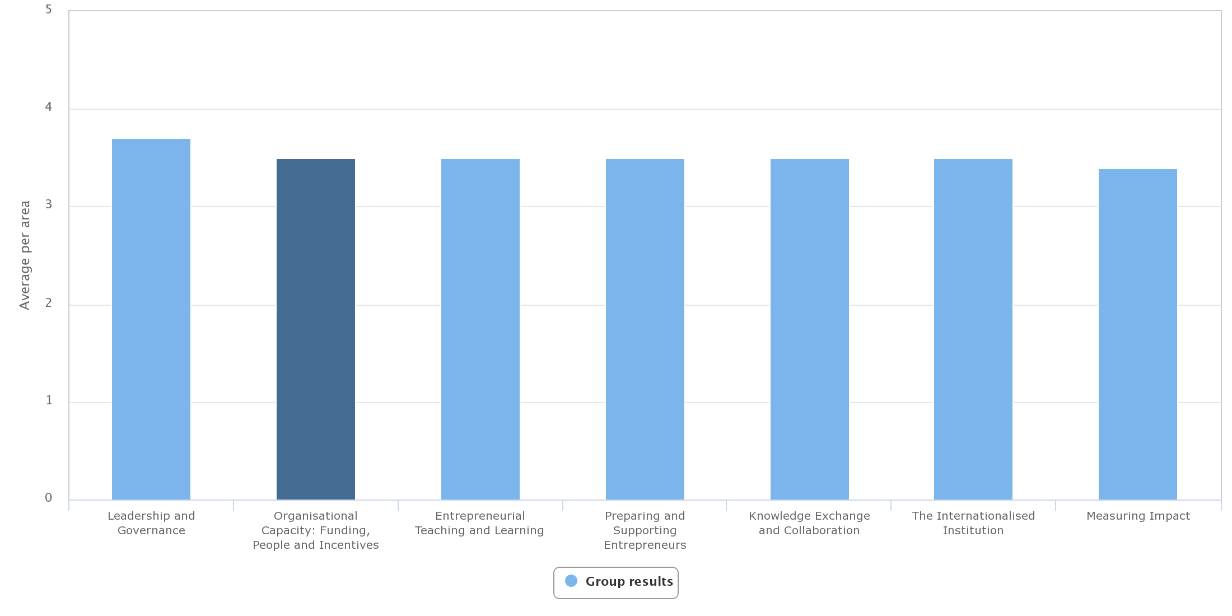
seven DIMENSION for self-assessment
Registered User: 316

Slide 3
Gita erasmus Action plan
Leadership & Governance

Slide 4
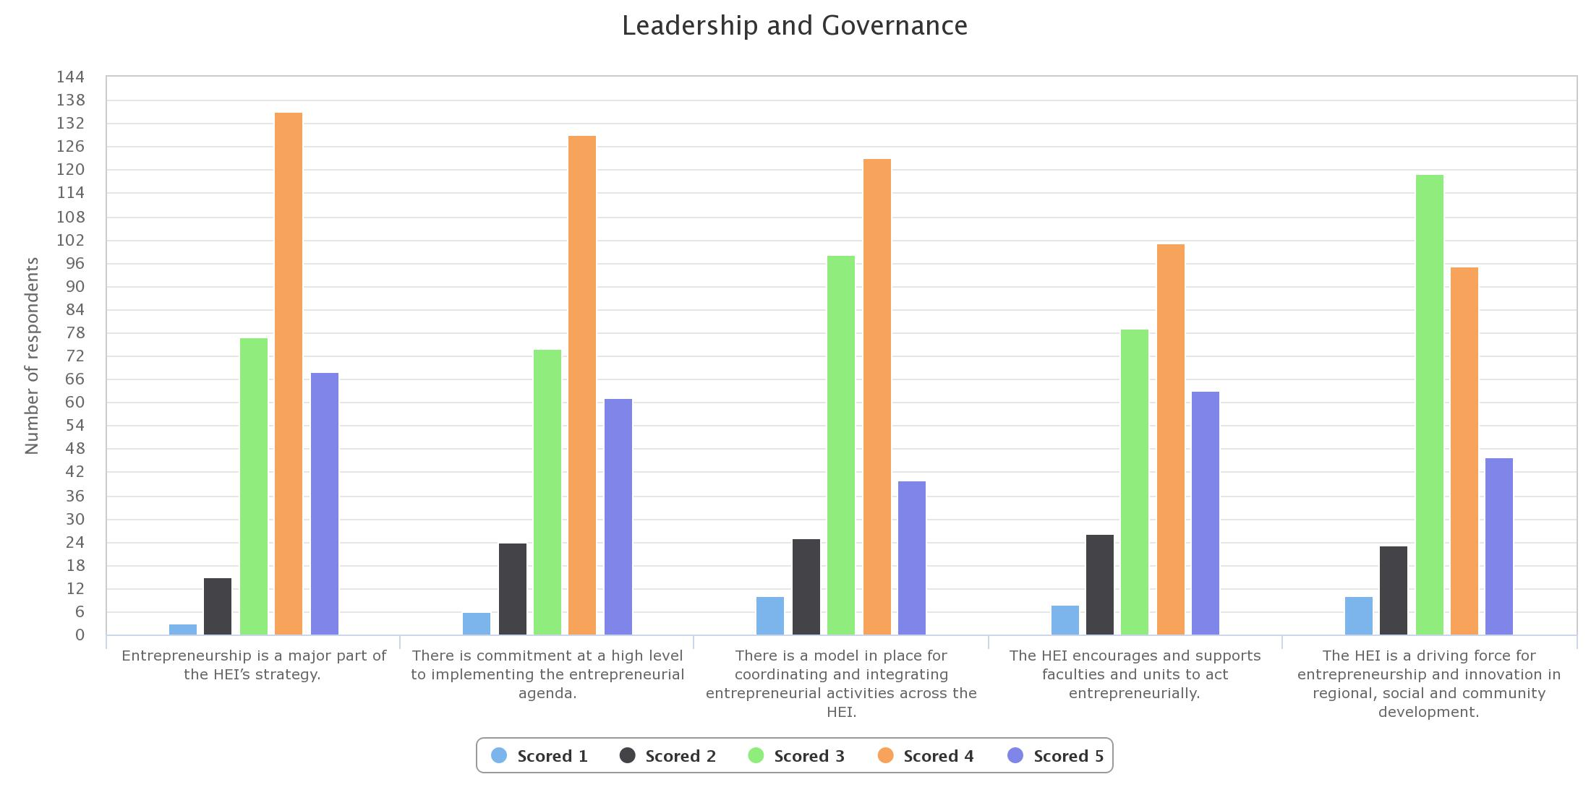
ASSESSMENT RESULT

Slide 5
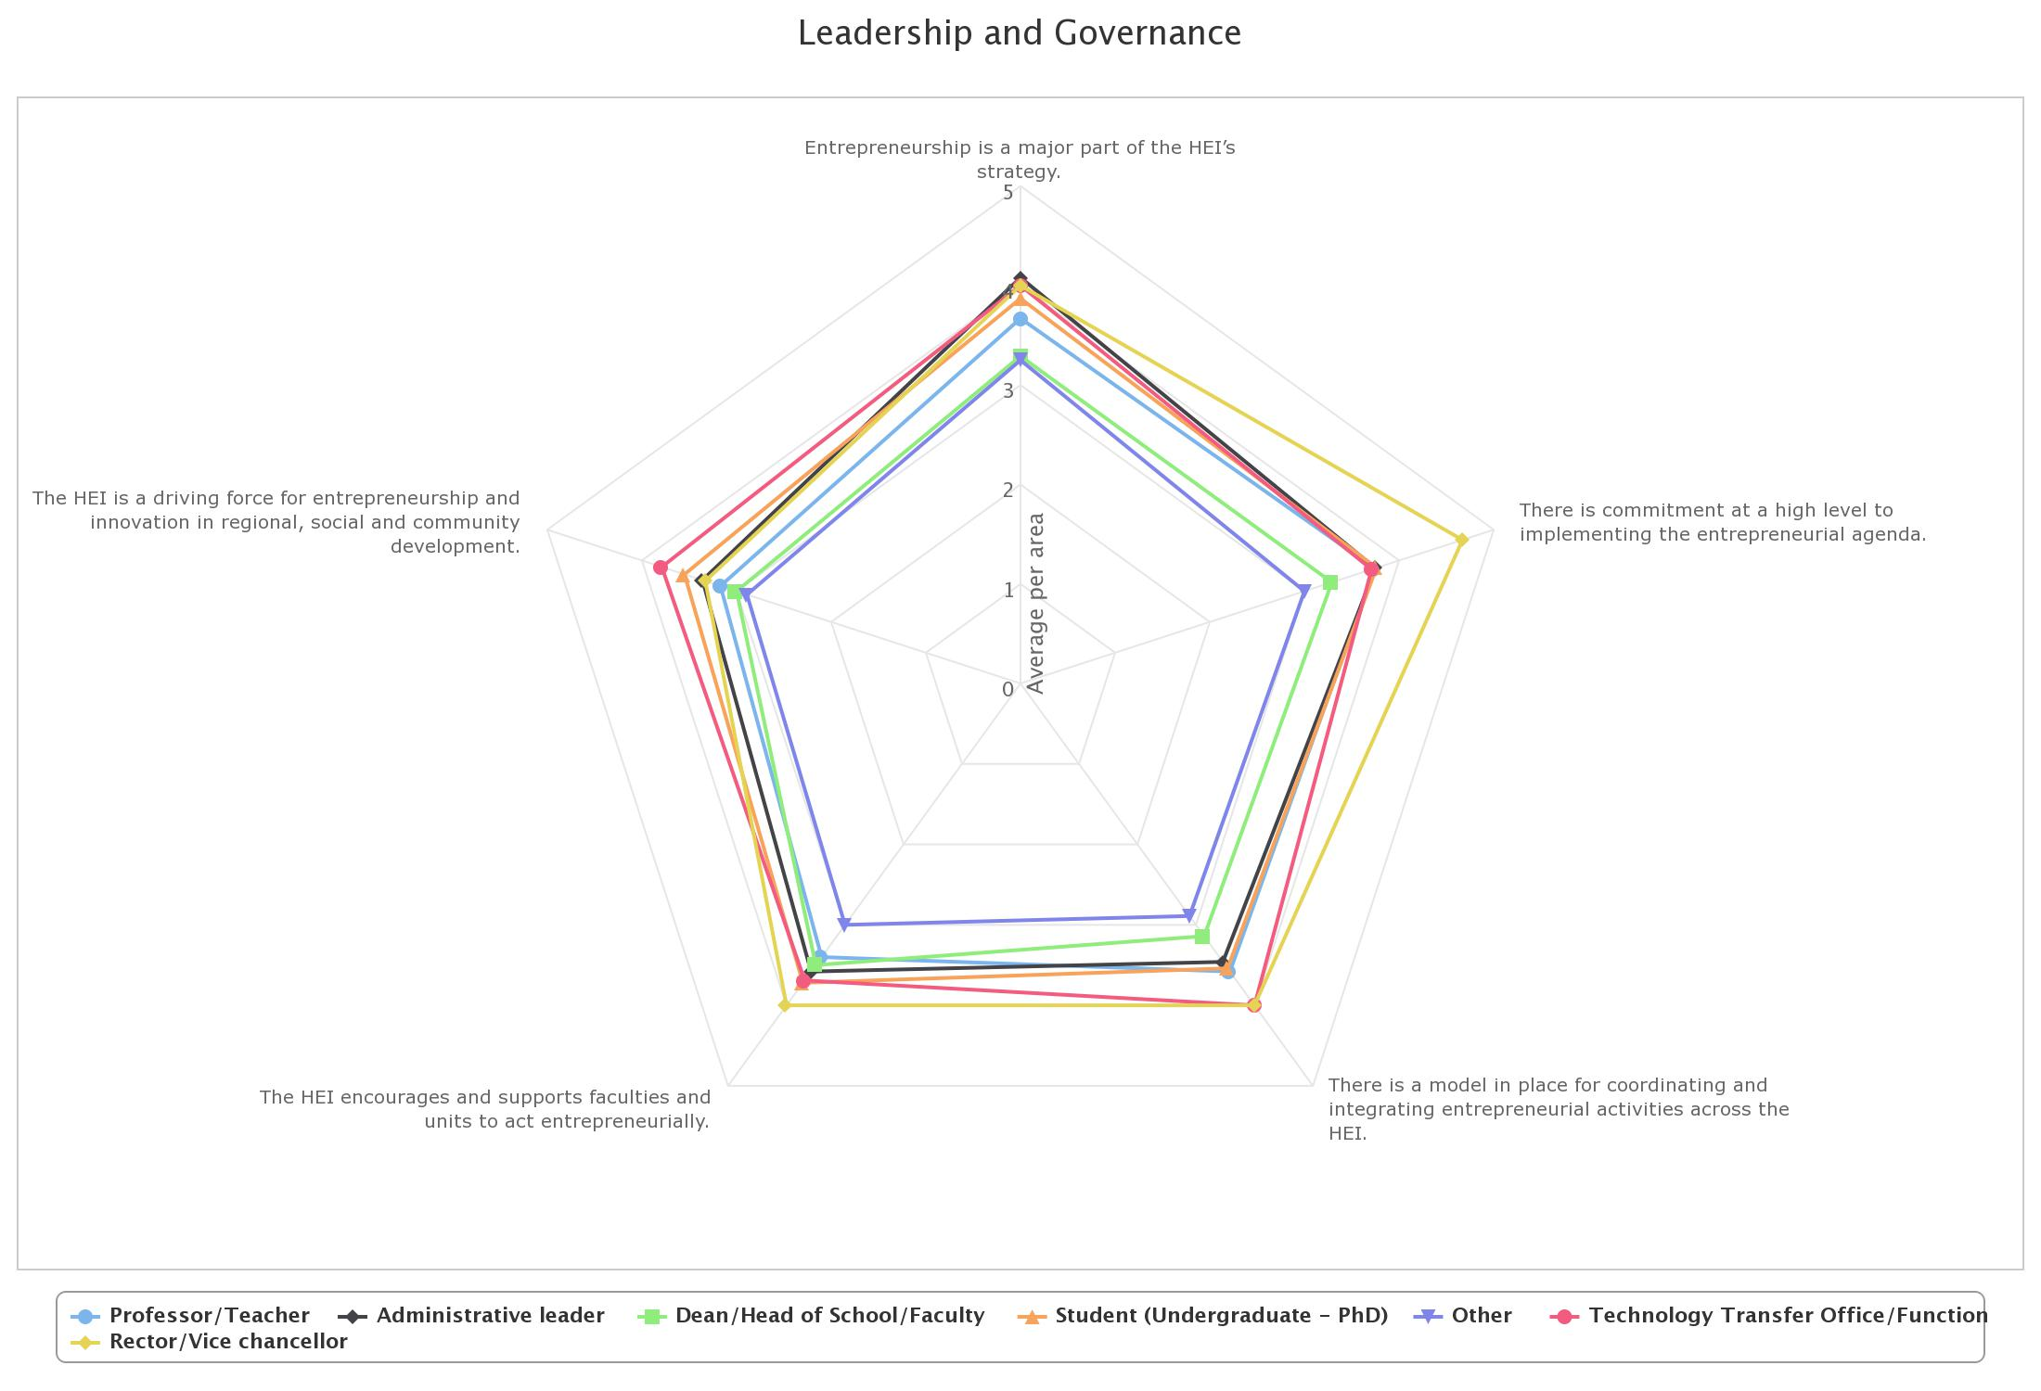
ASSESMENT RESULT

Slide 6
#1 ASPECT
Entrepreneurship is a major part of the HEI’s strategy
PROBLEM DEFINITION | PROGRAM | WORKPLAN | KPI
There are a little employees (specific at the dean and staff’s level) who still unsure that entrepreneurial being part of the vision, mission, and strategy | Increase the frequency of meetings/ discussion among entrepreneurs and employees (the dean & staff’s level) | Invite the entrepreneurs to discuss with employees (the dean and staff’s level) Organize company visit’s event with the employees (the dean and staffs level) | Invite entrepreneurs minimum 4 times a year Organize company visit minimum 3 times a year

Slide 7
#2 ASPECT
There is commitment at a high level to implementing the entrepreneurial agenda
PROBLEM DEFINITION | PROGRAM | WORKPLAN | KPI
There are a little employees (specific at the dean and staff’s level) who still unsure that there is management commitment to implementing the entrepreneurial agenda | Increasing the conviction of the employees (specific at the dean and staff's level), that there is management commitment to implement entrepreneurial agenda | Involve the dean and staff to make the entrepreneurial agenda Socialize roadmap entrepreneurial agenda | the majority of dean is attend when to create entrepreneurial agenda announce the entrepreneurial agenda through social media, website, and media internal

Slide 8
#3 ASPECT
There is a model in place for coordinating and integrating entrepreneurial activities across the HEI.
PROBLEM DEFINITION | PROGRAM | WORKPLAN | KPI
There are a little employees who still unsure that there is a model for coordinating and integrating entrepreneurial activities | Increase the involvement of the dean, head study program and staff through dialog/discussion forum to integrate the entrepreneurial activities across all faculties and study programs | create entrepreneurship’s dialogue forum across all unit attended by the dean, head study program and staff Invite all related parties through social media and other communication channels in entrepreneurial activities | the majority of the dean and head of study program attended on entrepreneurial dialogue forum

Slide 9
#4 ASPECT
The HEI encourages and supports faculties and units to act entrepreneurially
PROBLEM DEFINITION | PROGRAM | WORKPLAN | KPI
There are a little employees (the dean and staff) who still unsure that the University encourages and supports the faculties and units to act entrepreneurially | Improve the quality of the curricula and the entrepreneurial lectures Accelerating the growth of business incubator among the lecturers, students, and staff | Involve the faculties to create the curricula and entrepreneurial lectures Improve mentoring program to the new business incubator | curricula and lectures of entrepreneurial taught in some semesters the rise of the new business incubator at faculty and study program

Slide 10
#5 ASPECT
The HEI is a driving force for entrepreneurship and innovation in regional, social and community development.
PROBLEM DEFINITION | PROGRAM | WORKPLAN | KPI
There are a little employees who still unsure that the University is driving force for entrepreneurship and innovation in regional, social and community development | Accelerating the faculties, study program and business incubator to engage in social and community development and innovation in regional | Invite social entrepreneur to share experience and knowledge to the faculties Involve the dean, head of study program and staff in activities which is stimulate the innovation and social and community development | Invite entrepreneurs 4 times a year The raise of social entrepreneur Participate in the entrepreneurship competition at regional’s level

Slide 11
Gita erasmus Action plan
Organisational capacity: Funding, people and incentives

Slide 12
Area 2. Organisational Capacity: Funding, People and Incentives

Slide 13
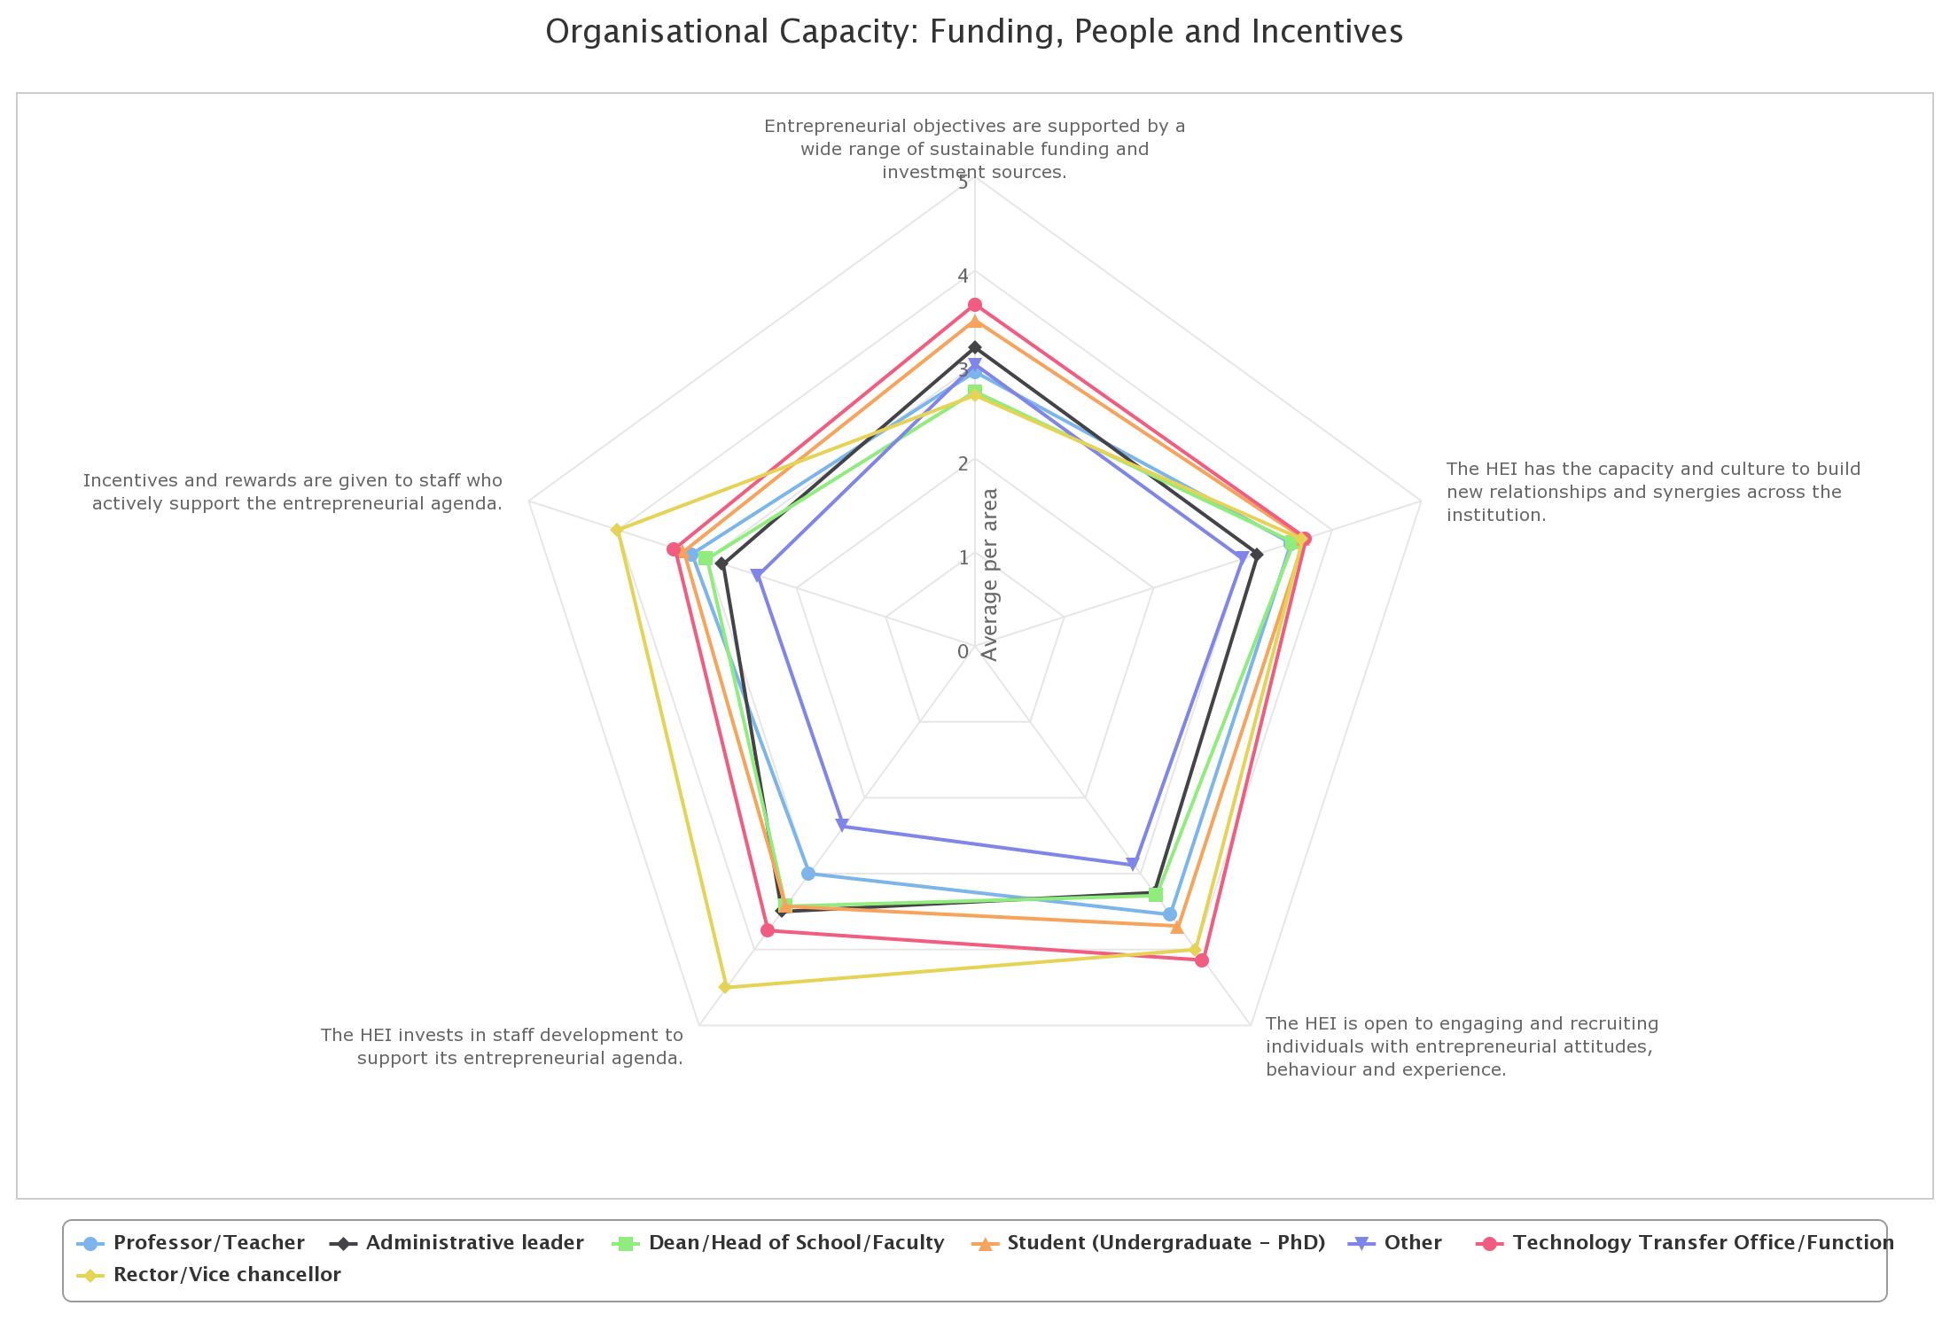
Area 2. Organisational Capacity: Funding, People and Incentives

Slide 14
Action plan Organisational capacity: Funding, people and incentives
Problem | Action Plan (Program) | Working Plan | Success Indicator
Need to invests in staff development to support its entrepreneurial agenda | Entrepreneurship training for → Gaining awareness, understanding and skill →Gaining funding and Investment Potential | Entrepreneurial Learning Program: Entrepreneurial Workshop for All Staff Entrepreneurial Pitching Training Program | Entrepreneurial Workshop and Pitching Training Program for All Staff are held regularly once every year All staff take turns to take part in all training
 | Work in Group for Structured movement Structured driving force Sharing knowledge | Building Advanced Learning Centre for Entrepreneurship Study Entrepreneurial Discussion Group “Young and Restless” | There is entrepreneurial movement layout There is entrepreneurial society

Slide 15
Gita erasmus Action plan
ENTREPRENEURIAL TEACHING AND LEARNING

Slide 16
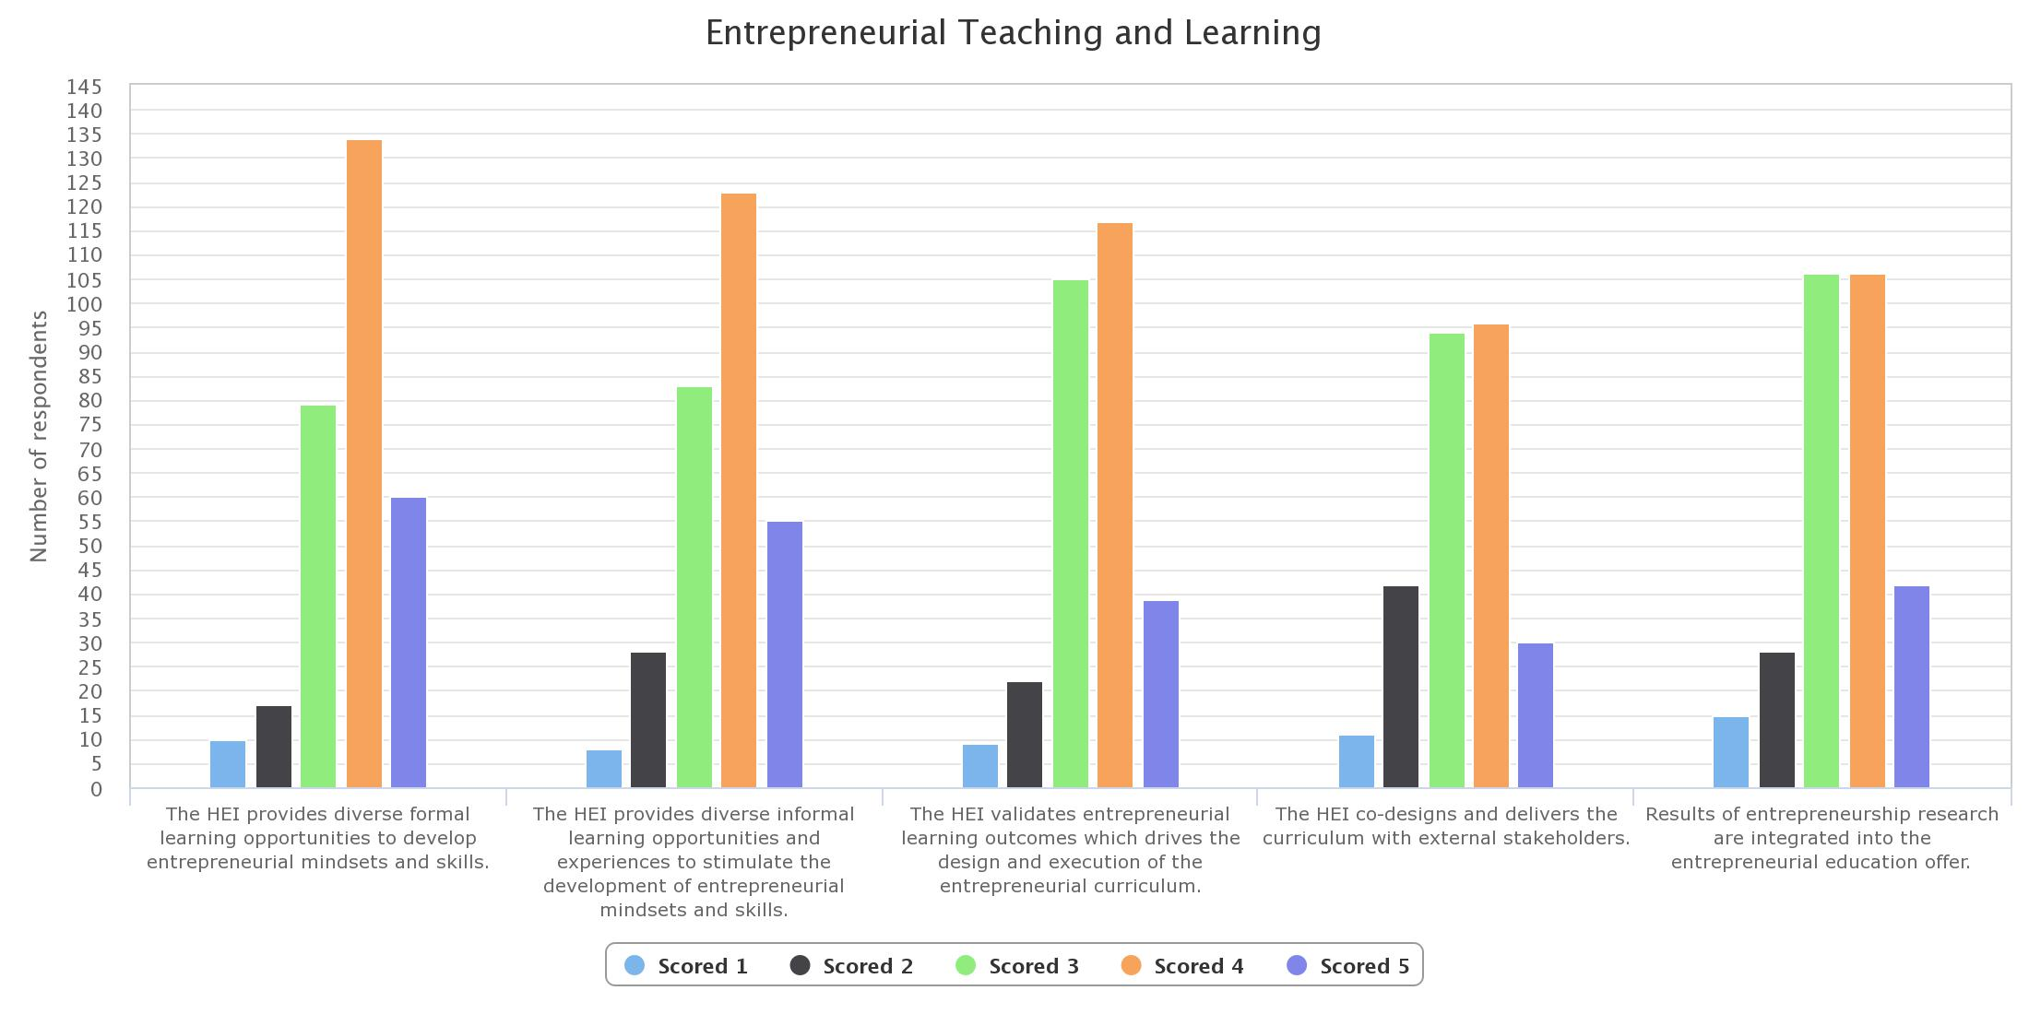

Slide 17
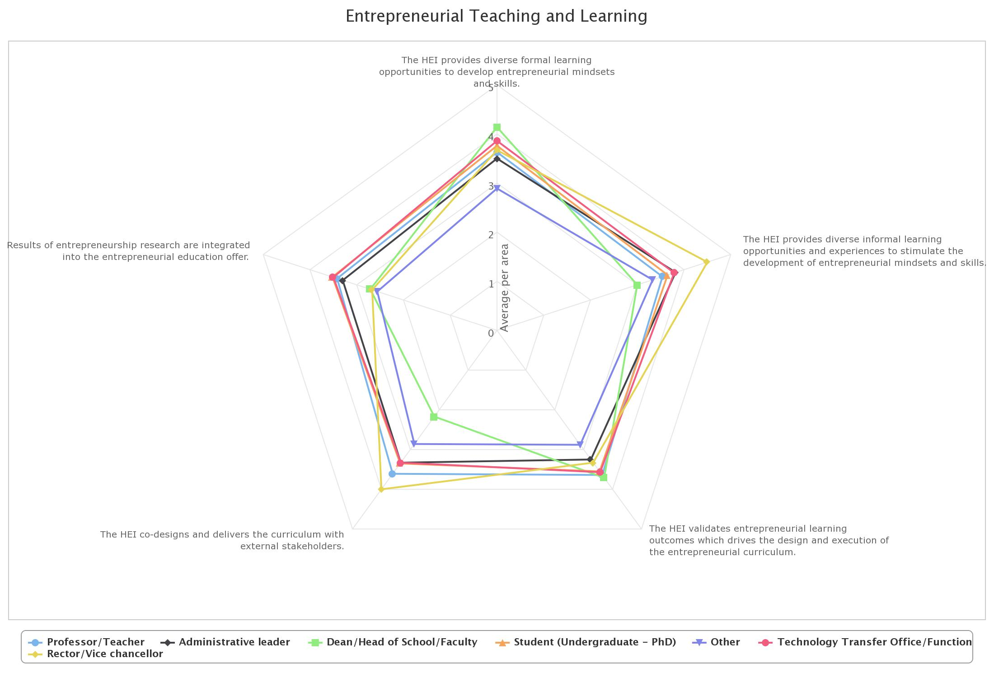

Slide 18
Action plan → ENTREPRENEURIAL TEACHING AND LEARNING
No | Problem | Action Plan (Program) | Working Plan | Success Indicator
1 | The HEI provides diverse formal learning opportunities to develop entrepreneurial mindsets and skills. The HEI validates entrepreneurial learning outcomes which drives the design and execution of the entrepreneurial curriculum | Improving and Perfecting the University’s Entrepreneurship Curriculum especially for first two subjects of Entrepreneurship 1 and 2 | provide proper and intensive training for lecturers who’s not from Entrepreneurship background before teaching entrepreneurship 1 and 2 | Lecturers who assigned to teach entrepreneurship 1 and 2 knows exactly how to run the class which intent to develop entrepreneurial mindset and skills of students.
 |  |  | Exposing current entrepreneurial life (start-up phenomenon and SME) to Entrepreneurship 1 and 2 lecturers | Lecturers are expected to have sufficient knowledge about entrepreneurship practices and able to deliver it to the students in a well manner.

Slide 19
Action plan → ENTREPRENEURIAL TEACHING AND LEARNING
No | Problem | Action Plan (Program) | Working Plan | Success Indicator
2 | The HEI provides diverse informal learning opportunities and experiences to stimulate the development of entrepreneurial mindsets and skills. Results of entrepreneurship research are integrated into the entrepreneurial education offer. | Disseminating information of entrepreneurship event (competition) to the whole university (across major) | Create Entrepreneurship related competition within University with across discipline/major involvement | Number of student groups, staff, and lecturers with multi discipline members
 |  |  |  | Creation and realization 3 High value ideas of start up per year
 |  | Conducting routine activity in form of sharing session with successful entrepreneur as a source to share knowledge, ideas, or even the latest research | Utilize the Business Incubator as the host for such event | Successfully conduct at least one “TALKS” in one month with successful entrepreneur as sources
 |  | Build and develop technical team for the Business Incubator. | Open recruitment for students, staff, and lecturers who interested in running Business Incubator | Number of students who has experience in running a business incubator. Especially for students.

Slide 20
Action plan → ENTREPRENEURIAL TEACHING AND LEARNING
No | Problem | Action Plan (Program) | Working Plan | Success Indicator
3 | The HEI co-designs and delivers the curriculum with external stakeholders. | increase involvement of Existing Business Accelerator and/or industry to formulate and deliver entrepreneurship curriculum (Mindset and Idea) | Accelerate partnership with external stakeholders especially business accelerator, company, and financial institution in regards to co-create entrepreneurship curriculum | Mix delivery between external source and lecturer with certain proportion in one semester for all entrepreneurship subject. (To be applied in entrepreneurship1, entrepreneurship 2, corporate entrepreneurship, Start-up final project)
 |  |  | Team Teaching in Entrepreneurship subject with external source such as successful business accelerator, company, and Financial institution
 |  | Increase involvement with financial institution to formulate entrepreneurship curriculum (finance and funding)

Slide 21
Gita erasmus Action plan
Preparing and supporting entrepreneurs

Slide 22
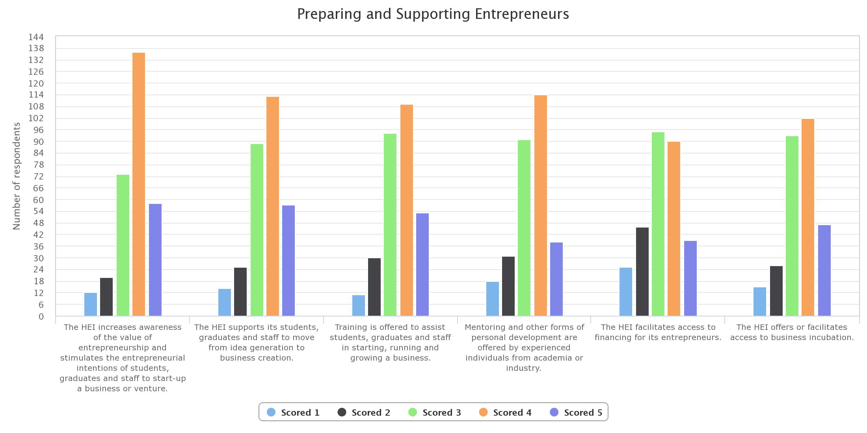

Slide 23
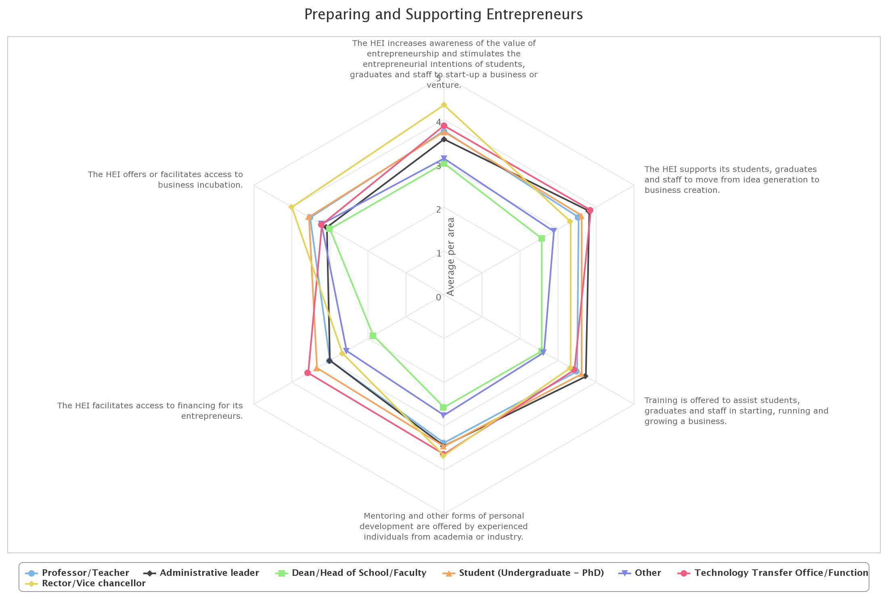

Slide 24
Action plan Preparing and supporting entrepreneurs
Problem | Action Plan (Program) | Working Plan | Success Indicator
There are huge gaps of perception between executives (vice-chancellor and his deputy) and dean/head of programs in every indicators of preparing and supporting entrepreneurs | Wide range of mandatory entrepreneurship program in faculty level | Running immersion program for dean/head of programs in high growth startup companies Establishing academics – industry practitioners team teaching mandatory courses Establishing mandatory entrepreneurship related subject that cooperate with business incubator | 20% of dean/head of programs have conducted startup immersion in each year At least 1 course has conducted with academics – industry practitioners team teaching scheme per semester for each programs At least 1 course has collaboration with business incubators per semester for each program

Slide 25
Action plan Preparing and supporting entrepreneurs
Problem | Action Plan (Program) | Working Plan | Success Indicator
There are limited access to financing for student entrepreneurs | Explore new financing opportunities for student entrepreneurs from external parties | Running periodical workshop to access entrepreneurship grants Trying to apply various entrepreneurship grants constantly Establishing alumni and HEI network channel to help financing access for students entrepreneurs through investment, crowdfunding or softloan | 2 workshops are created every year with 15 participated student in each workshops 30 applicants in a year, 7 applications are successful to get some grants The financing ecosystem with alumni and HEI network is established with minimum 10 financing activities per year

Slide 26
Action plan Preparing and supporting entrepreneurs
Problem | Action Plan (Program) | Working Plan | Success Indicator
There are limited access to financing for student entrepreneurs | Exploit financing opportunities for student entrepreneurs from internal parties | Running workshops for students to enhance their technical skills that related with internal projects Outsourcing internal projects to student entrepreneurs Excalate the student projects to HEI network | There are bi-weekly workshop to enhance students entrepreneurs technical skill with 15 participated students in each workshop 24 internal projects are established in a year 12 projects from HEI network are established in a year

Slide 27
Gita erasmus Action plan
KNOWLEDGE EXCHANGE AND COLLABORATION

Slide 28
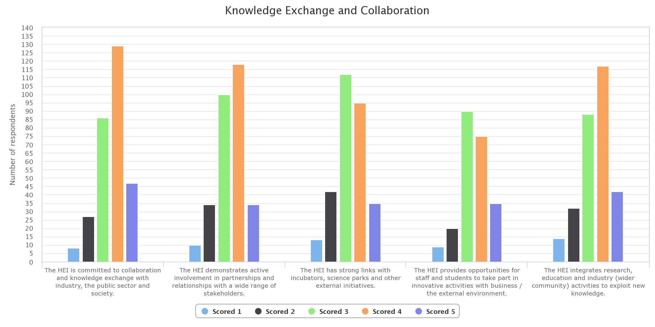

Slide 29
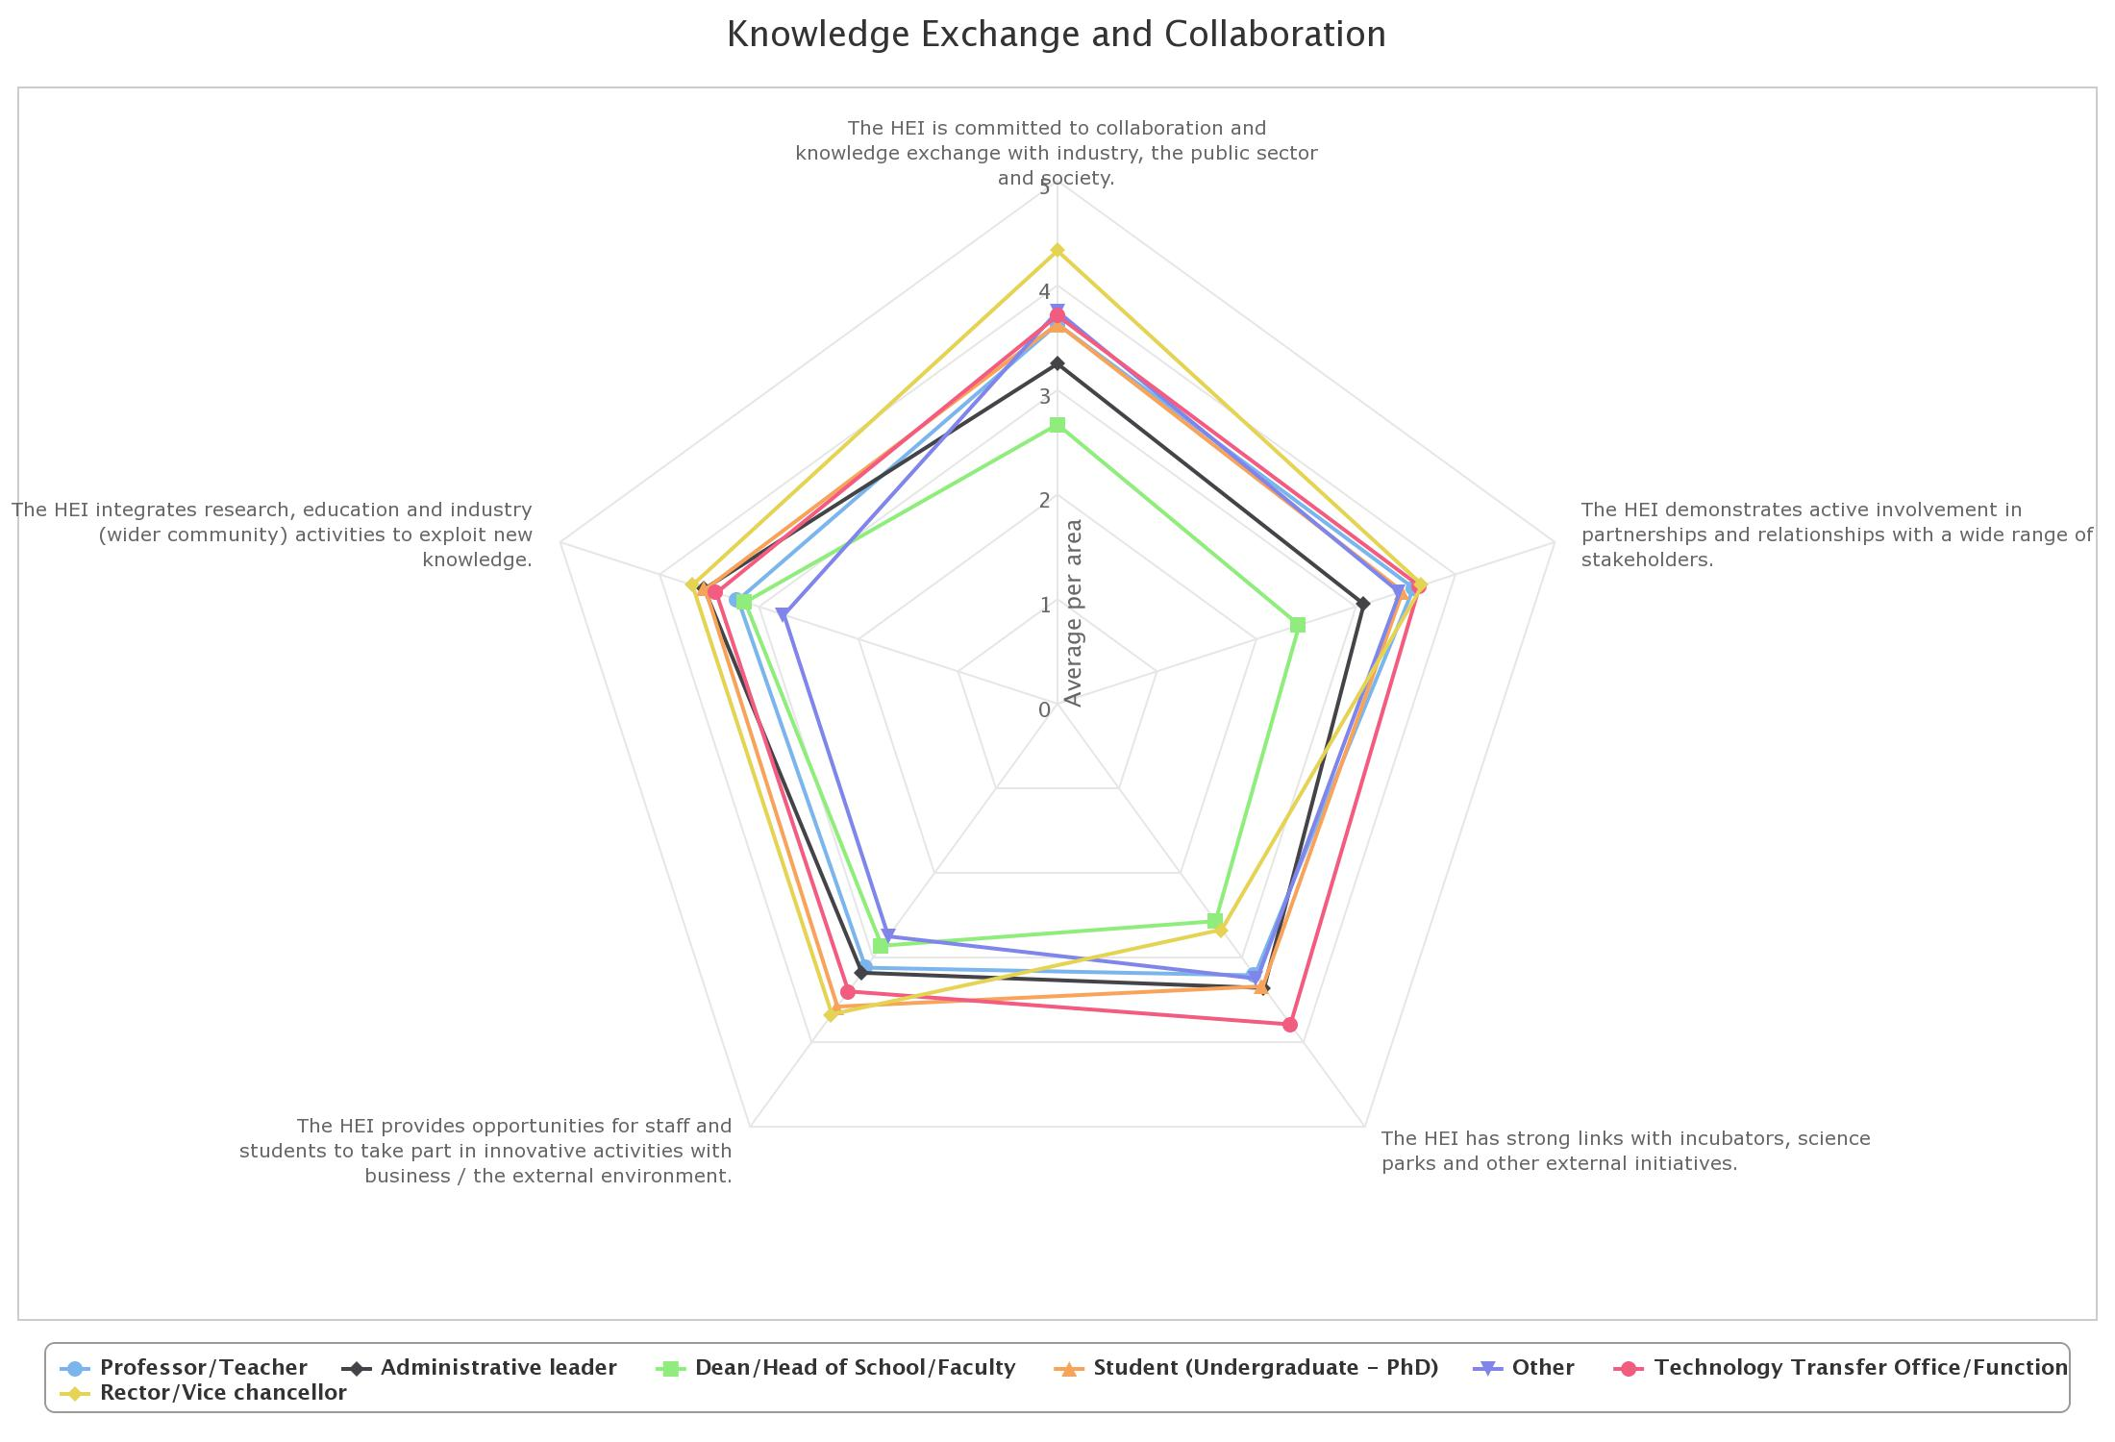

Slide 30
Action plan
No | Problem | Action Plan (Program) | Working Plan | Success Indicator
1 2 | The HEI has committed to committed to collaboration and knowledge exchange with industry, the public sector and society. The HEI demonstrates active involvement in partnerships and relationships with a wide range of stakeholders : Rector/vice chancellors consider that PRU has committed to collaboration and knowledge exchange with industry, the public sector and society. They also consider that the University has demonstrated active involvement in partnerships and relationships with a wide range of stakeholders. Whereas the Dean/Head of School/Faculty think otherwise. | Maintaining mutual dialogue/collaboration with local stakeholders and industry | The University to offer unique trainings (language, etc.) to companies in the region | Monthly training for executives and for staff (depend on the resources and needs)
 |  |  | The University to offer research collaborations with industries in the region | Published research papers in national/international journals
 |  |  | The University to establish more collaboration with business partners or companies in terms of human resources (PRU student internship programs, etc.) | Increased number of partnerships and/or internships opportunities
 |  | Enhancing partnerships with government | The University to facilitate focus group discussions (FDGs) inviting government and other stakeholders | Academic papers (as policy recommendation for the government)
 |  |  | The University to organize annual conference on Academic-Business-Government relations in industry sector | One annual conference (supported/sponsored by business partners and government)
 |  | Disseminating information about partnerships within PRU | Monthly meeting plan on partnerships update (Rector to Deans/Heads) | Every meeting is attended by at least 75% of invitees
 |  |  | Monthly meeting plan on partnerships update (Deans/Heads to all faculty members) | Every meeting is attended by at least 75% of invitees
 |  |  | Announcement board (or other digital platforms) on partnerships updates | Updated once in a month

Slide 31
Action plan
No | Problem | Action Plan (Program) | Working Plan | Success Indicator
3 | The HEI has strong links with incubators, science parks, and other external initiatives Technology Transfer Office staff agree that the University has strong links with incubators, science parks, and other external initiatives, whereas both Rector/Vice Chancellors and Dean/Head of School/Faculty disagrees. | Supporting engagement among business partners and other stakeholders for capacity building for knowledge exchange | The University to provide open spaces for collaboration and networking by making use of the available rooms in the university as the hub for activities related to fostering knowledge exchange with external parties | The establishment of the open spaces in the university
 |  |  | The University to provide co-working space for university students that is accessible to all students in the region | The establishment of the co-working space
 |  |  | The University to collaborate with other university-based incubators | Organizing monthly programs/activities
 |  | Establishing internal organization and international links | The University to be a member of international organizations that fund newly created incubators | Becoming a member and identifying 10 potential partners
 |  |  | The University to start partnerships with companies that can provide start-up creating and coaching | Starting partnerships with at least 10 national/international companies
 |  |  | Establishing Students Innovation Club which actively conducts events such as innovation fair, etc. | The establishment of Student Innovation Club

Slide 32
Gita erasmus Action plan
The internationalised institution

Slide 33
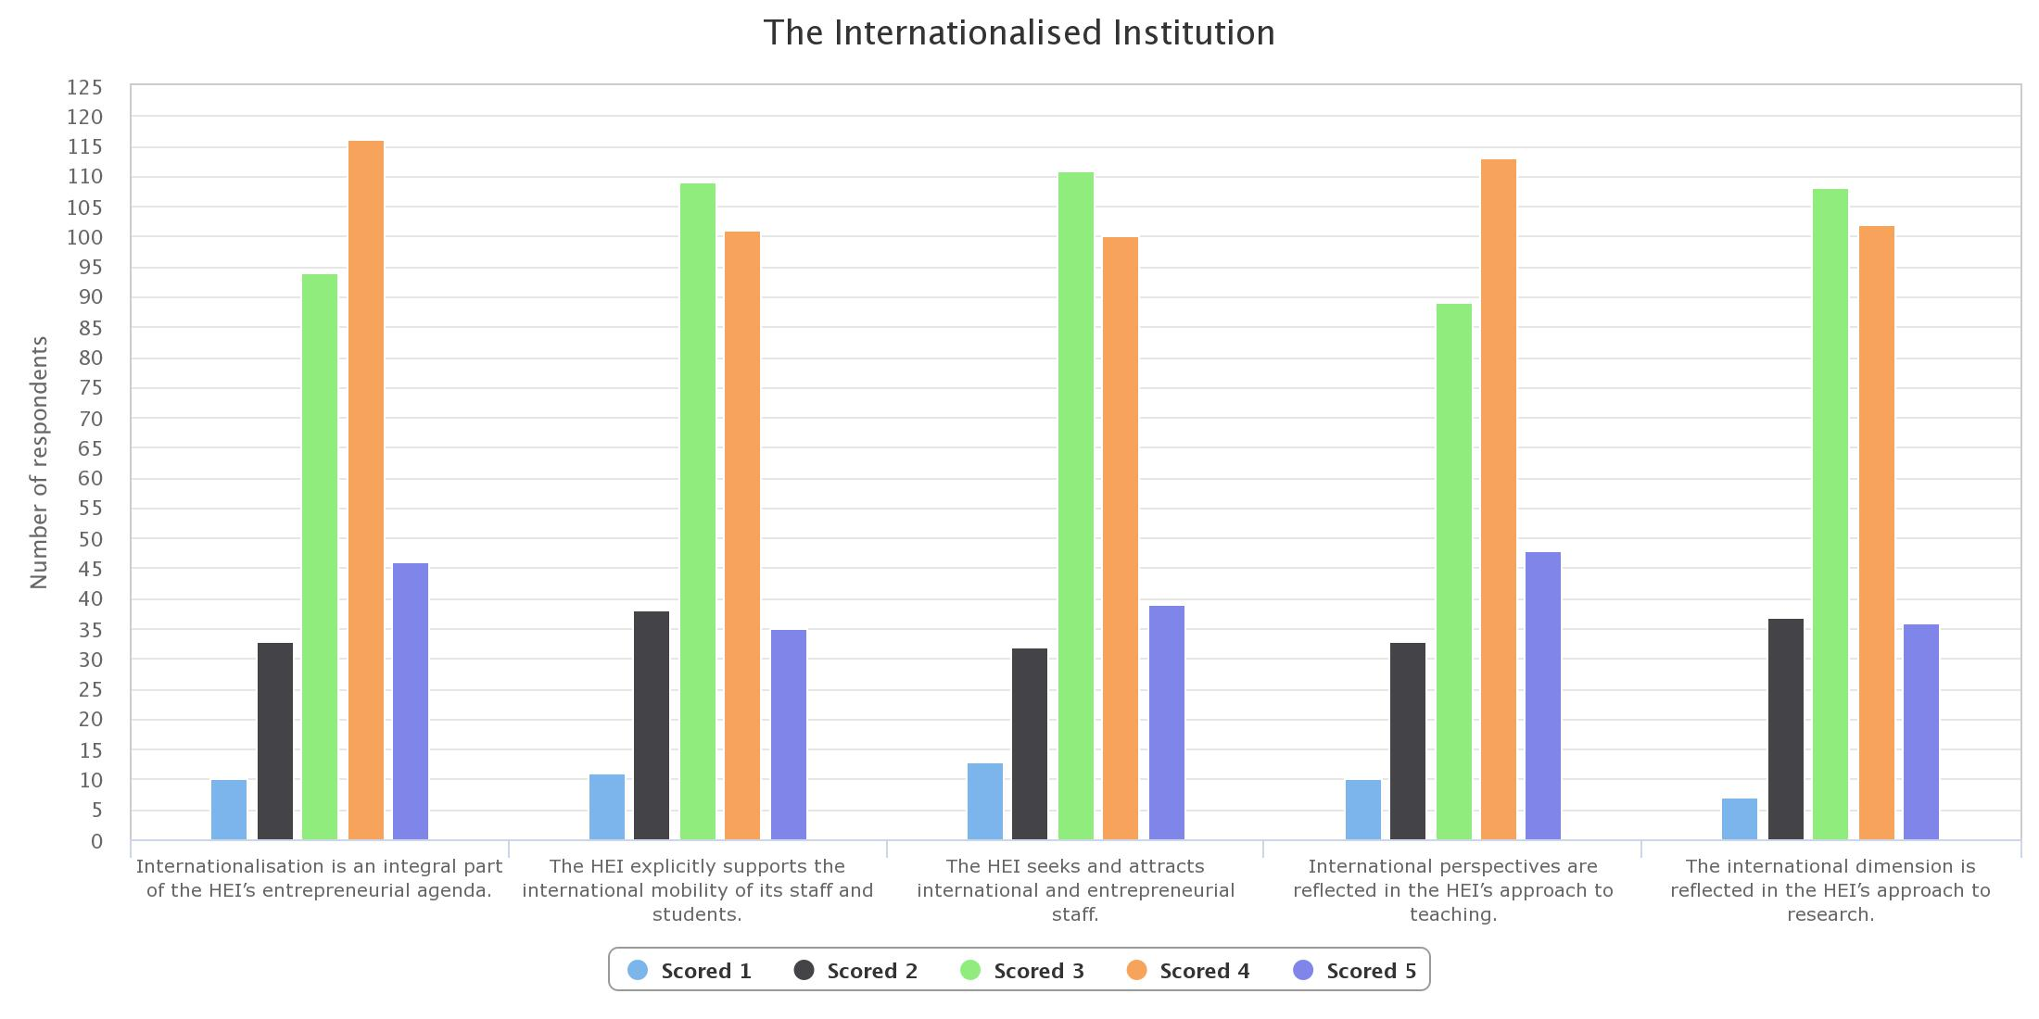

Slide 34
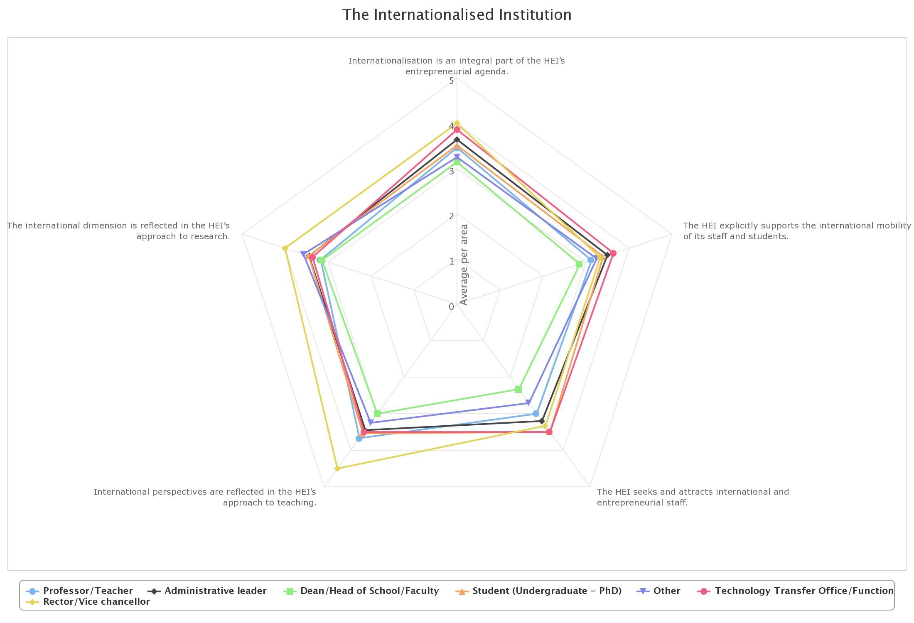

Slide 35
Number | Problem | Action Plan | Work Plan | Measure of Success
1. Internationalisation is an integral part of the HEI’s entrepreneurial agenda | There is a huge gap in the perspective between most of the responders. The most glaring difference is the view between the lecturers compared to those of the heads of faculties/study programs and the top management | We need to assimilate the information on our internationalisation program We need to introduce our entrepreneurship program | We need to put a more detailed information on our website for both our internationalisation and entrepreneurship programs We need to have regular meeting sessions between the International Partnerships Office and the Business Incubator with the Deans and Heads of Study Programs | Deans and head of study programs are fully aware of our internationalisation and entrepreneurship program Both the International Partnerships Office and each study programs create collaborative programs that will benefit the university as a whole Our students are included in the program

Slide 36
Number | Problem | Action Plan | Work Plan | Measure of Success
2. The HEI explicitly supports the international mobility of its staff and students | The deans and heads of study programs perceive the international mobility as something that has not been optimized quite yet. The top management think that the international mobility that we have is already quite successful | We need to create and integrated plan where our students and faculty members are able to be actively involved in the mobility program The international mobility program need to be tailored specifically to the needs of the faculty members and students | We neeed to create a program where at least 1 member of each faculty or study programs is involved in a yearly mobility program We need to send at least 1 student from each study program on a mobility program once yearly.

Slide 37
Gita erasmus Action plan
Measuring impact

Slide 38
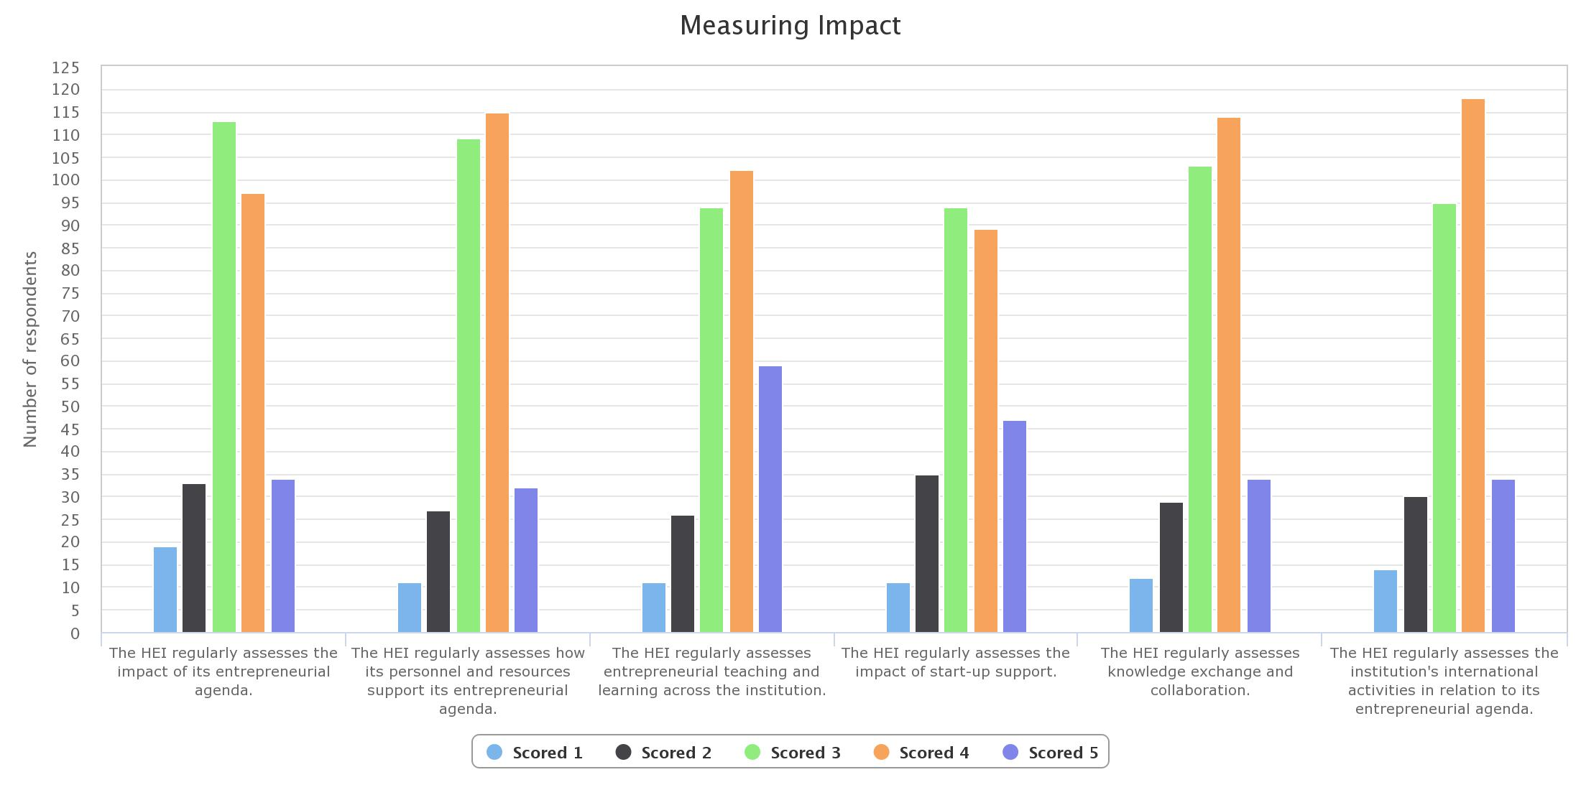

Slide 39
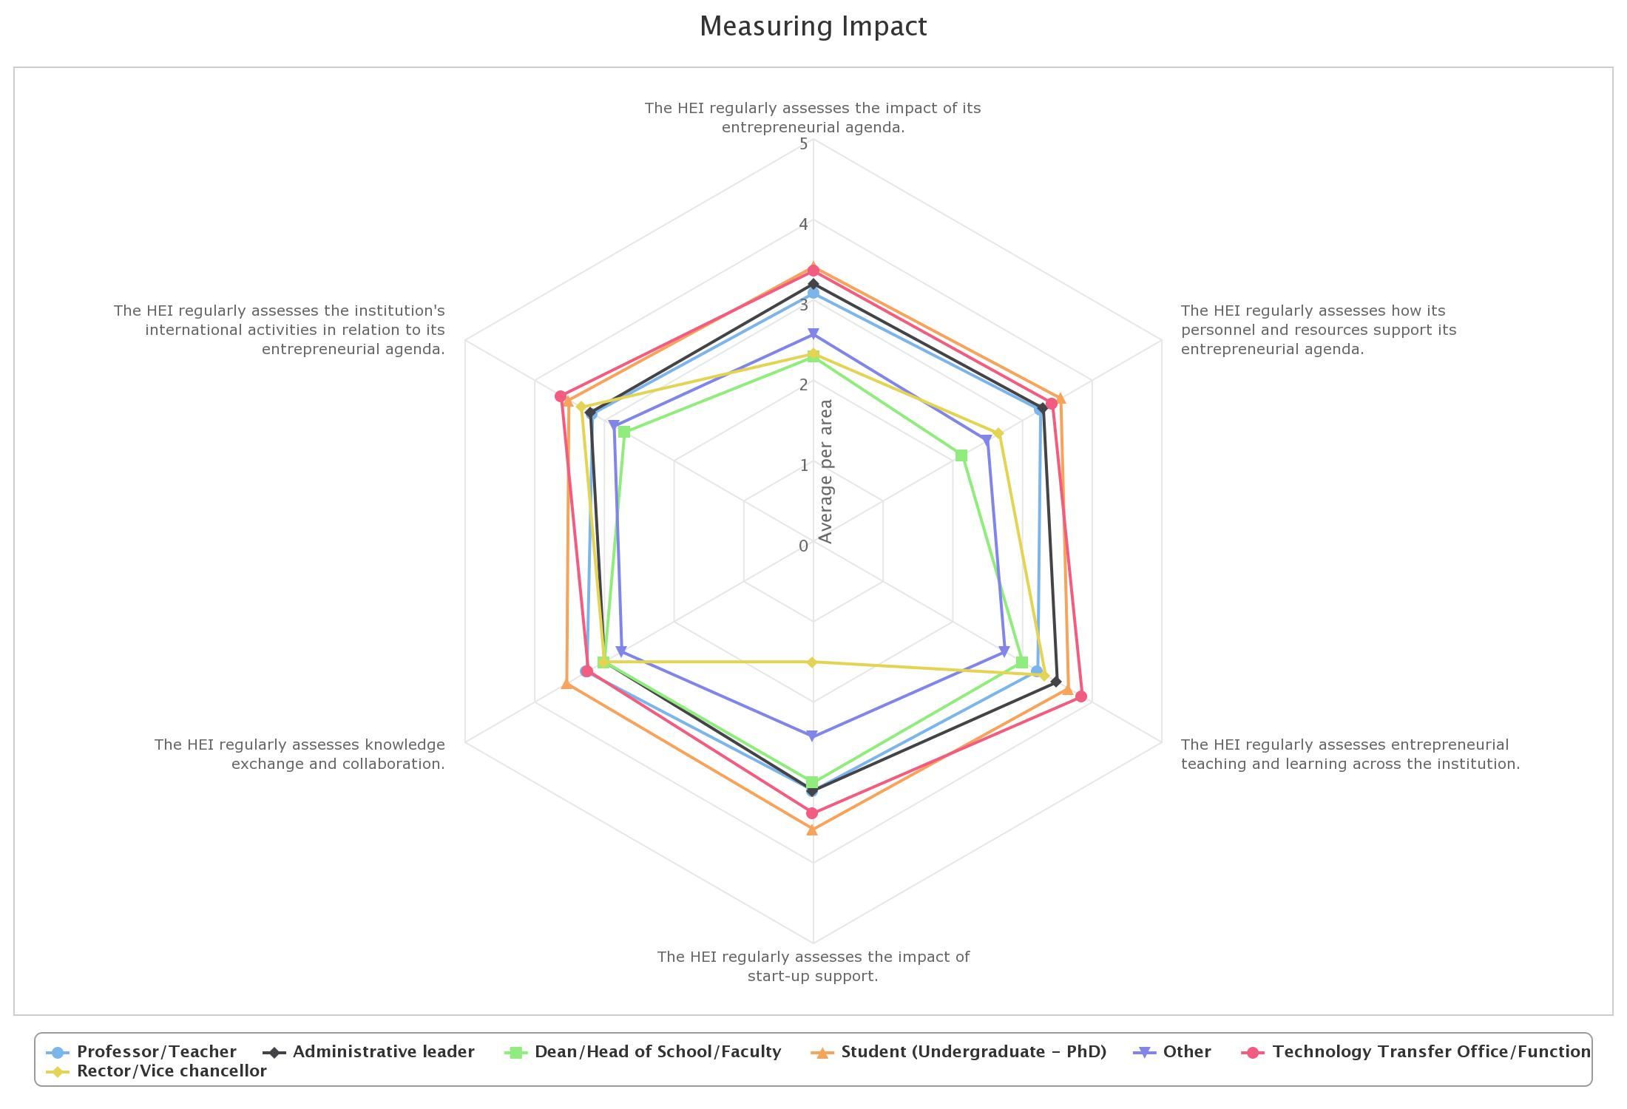

Slide 40
Action plan → measuring impact
No | Problem | Action Plan (Program) | Working Plan | Success Indicator
1 | The University regularly assesses the impact of its entrepreneurial agenda | Build high understanding about of how important entrepreneurship is to the governing and all executive boards | Doing a comparative study toward entrepreneurial education through joint the seminar or workshop about entrepreneurial agenda by all the excutive boards | Visit and participate the seminar or workshop about entrepreneurial periodically in order to improve the understanding
 |  |  | Establish internal meeting among excutive boards in order to sharing the idea about the entrepreneurial agenda | Scheduling monthly internal meeting that specialized discussed about entrepreneurial agenda
 |  |  | Invite entrepreneurs to come to Pres Univ in order to share the idea about entrepreneurial agenda (in house training) | Scheduling periodically sharing session between the executive boards and the entrepreneurs from any industries.

Slide 41
Action plan → measuring impact
No | Problem | Action Plan (Program) | Working Plan | Success Indicator
1 | The University regularly assesses the impact of its entrepreneurial agenda | Establish strong awarenes about the entrepreneurial agenda by all the stakeholders, especially rector, dean, lecturer, student and staff | Conduct sharing session about enrepreneurial education with all stakeholders especially rector, dean, lecturer, student and staff | Conduct sharing session with all stakeholders periodically (monhtly)
 |  |  | Promoting the entrepreneurial education knowedge through several media | Create the event that invite the entrepreneurs as a keynote and the stakeholder especially rector, dean, lecturer, student and staff as an audience Promote the entrepreneurial education information through website and other social media as a promotion tools periodically

Slide 42
Action plan → measuring impact
No | Problem | Action Plan (Program) | Working Plan | Success Indicator
1 | The University regularly assesses the impact of its entrepreneurial agenda | Formulate formal mechanism in order to ASSESS the awarenes of entrepreneurial agenda | Establish small team which is synergy with the QA department in Pres Univ in order to formulate the formal mechanism for assessing the awareness of entrepreneurial education | There are weekly meeting about formulating the formal mechanism for assessing the awareness
 |  |  |  | Give the progress report to the executive boards about the formal mechanism for assessing the awareness of enrepreneurial education

Slide 43
Action plan → measuring impact
No | Problem | Action Plan (Program) | Working Plan | Success Indicator
1 | The regularly assesses the impact of its entrepreneurial agenda | Implement formal mechanism in order to ASSESS the awarenes of entrepreneurial agenda | Formulate the procedures to conduct the survey | Meeting the internal small team about the content about the awareness of entrepreneurial agenda: Are students, academic and administrative staff aware of the agenda? Are they involved in the design, implementation and evaluation of the agenda?
 |  |  | Setting the budget to conduct the survey | Budget report for several procedures during conduct the survey
 |  |  | Conduct the survey | Disseminate the questionnaires that in line with the budget and procedures within certain period of time
 |  |  | Create the report | Analyze the result Define the problem Give report (recommendation) of the result to the executive board

Slide 44
Gita erasmus Action plan
SUMMARY

Slide 45
CORE PROBLEM
There are a little employees (specific at the dean and staff’s level) who still unsure that there is management commitment to implementing the entrepreneurial agenda
Need to invests in staff development to support its entrepreneurial agenda
Results of entrepreneurship research are still less integrated into the entrepreneurial education offer
There are huge gaps of perception between executives (vice-chancellor and his deputy) and dean/head of programs in every indicators of preparing and supporting entrepreneurs
Rector/vice chancellors consider that PRU has committed to collaboration and knowledge exchange with industry, the public sector and society. They also consider that PRU has demonstrated active involvement in partnerships and relationships with a wide range of stakeholders. Whereas the Dean/Head of School/Faculty think otherwise.
The deans and heads of study programs perceive the international mobility as something that has not been optimized quite yet. The top management think that the international mobility that we have is already quite successful
The HEI has not regularly assesses the impact of its entrepreneurial agenda

Slide 46
CORE ACTION PLAN
Increasing the conviction of the employees (specific at the dean and staff's level), that there is management commitment to implement entrepreneurial agenda
Entrepreneurship training for gaining awareness, understanding and skill
Build and develop technical team for HEI Business Incubator.
Wide range of mandatory entrepreneurship program in faculty level
Disseminating information about partnerships within PRU
The international mobility program need to be tailored specifically to the needs of the faculty members and students
Implement formal mechanism in order to ASSESS the awareness of entrepreneurial agenda

Slide 47
Thank you
Disclaimer: "This project has been funded with support from the European Commission. This communication reflects the views only of the author, and the Commission cannot be held responsible for any use which may be made of the information contained therein"

